Slide 1
CSC 441- Natural language processing
Senior Associate professor Faiz ul haque Zeya.

Slide 2
What is NLP (Natural language processing)
Natural Language Processing (NLP) is a subfield of artificial intelligence (AI). It helps machines process and understand the human language and can also generate human language so that they can automatically perform repetitive tasks. Examples include machine translation, summarization, ticket classification, and spell check. Generation examples includes question answering and chatbots like OpenAI ChatGPT, Google Bard and Microsoft Bing Chat.

Slide 3
NLP combines computational linguistics—rule-based modeling of human language—with statistical, machine learning, and deep learning models.

Slide 4
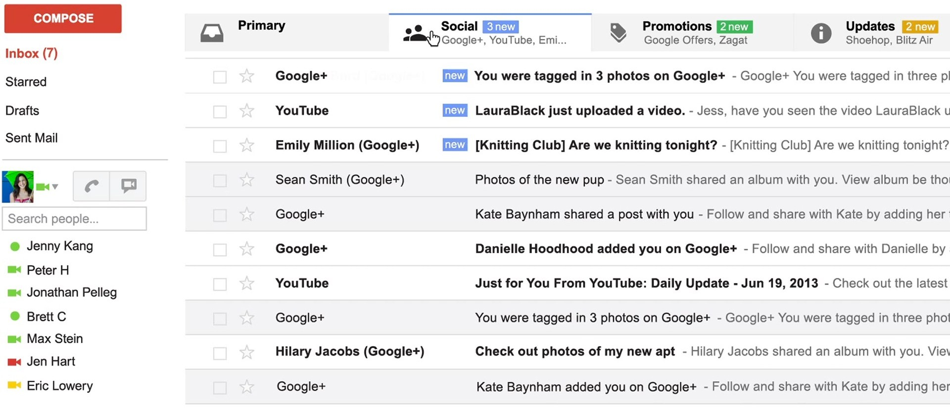
Text Classification
4

Slide 5
Text Classification
spam / not spam
priority level
category (primary / social / promotions / updates)
5

Slide 6
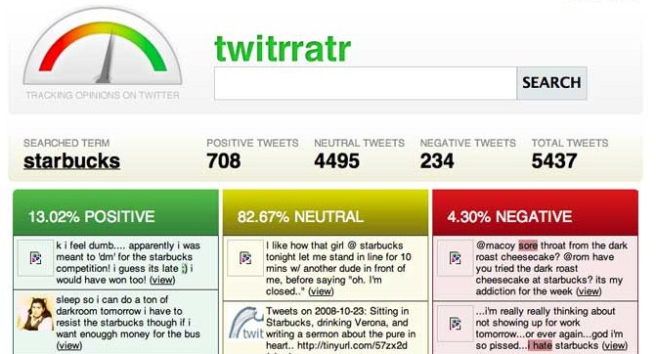
Sentiment Analysis
6

Slide 7
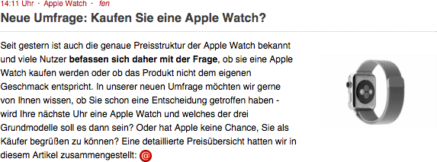
Machine Translation
7

Slide 8
Machine Translation
New Poll: Will you buy an Apple Watch?
8

Slide 9
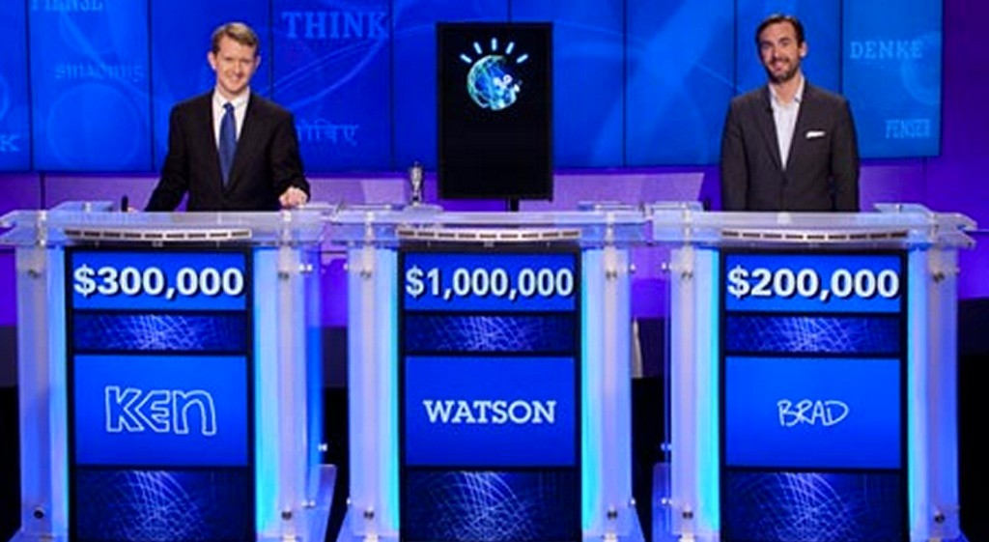
Question Answering
9

Slide 10

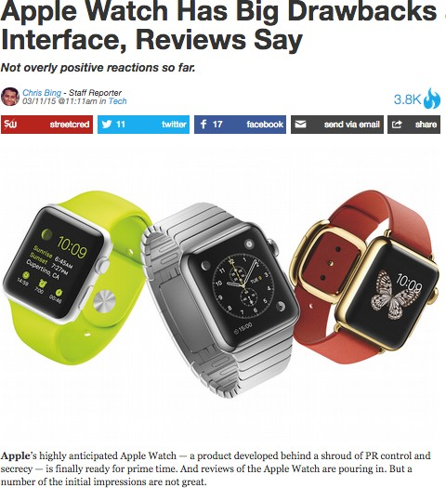
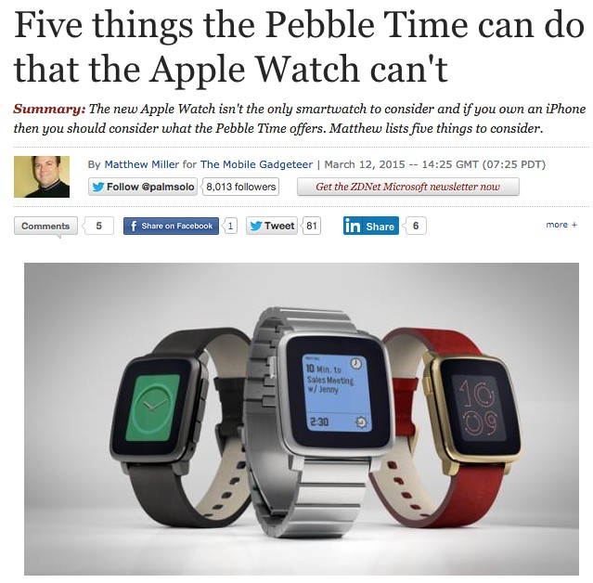
Summarization
10

Slide 11
Summarization
The Apple Watch has drawbacks. There are other smartwatches that offer more capabilities.
11

Slide 12
Dialog Systems
user: Schedule a meeting with Matt and David on Thursday. computer: Thursday won’t work for David. How about Friday? user: I’d prefer Monday then, but Friday would be ok if necessary.
12

Slide 13
Part-of-Speech Tagging
Some
questioned if Tim
be a breakaway
Cook
hit for
’s first product
would
Apple .
13

Slide 14
Part-of-Speech Tagging
proper verb (past) prep. noun questioned if Tim
proper noun Cook
determiner
Some
modal
would
poss. adj.
’s first
noun
product
punc.
.
proper
verb det. adjective
be a breakaway
noun prep.
hit for
noun
Apple
14

Slide 15
Named-entity recognition (NER)
Named-entity recognition (NER) (also known as (named) entity identification, entity chunking, and entity extraction) is a subtask of information extraction that seeks to locate and classify named entities mentioned in unstructured text into pre-defined categories such as person names, organizations, locations, medical codes, time expressions, quantities, monetary values, percentages, etc

Slide 16
Part-of-Speech Tagging
proper
proper noun Cook
determiner
Some
verb (past) prep. noun
questioned
poss. adj. noun
’s first product
if Tim
proper
modal | verb | det. | adjective | noun | prep. | noun | punc.
would | be | a | breakaway | hit | for | Apple | .
Named Entity Recognition
Some questioned if Tim Cook’s first product would be a breakaway hit for Apple.
PERSON ORGANIZATION
16

Slide 17
Dependency grammar (DG)
Dependency grammar (DG) is a class of modern grammatical theories that are all based on the dependency relation (as opposed to the constituency relation of phrase structure) and that can be traced back primarily to the work of Lucien Tesnière. Dependency is the notion that linguistic units, e.g. words, are connected to each other by directed links. The (finite) verb is taken to be the structural center of clause structure. All other syntactic units (words) are either directly or indirectly connected to the verb in terms of the directed links, which are called dependencies

Slide 18
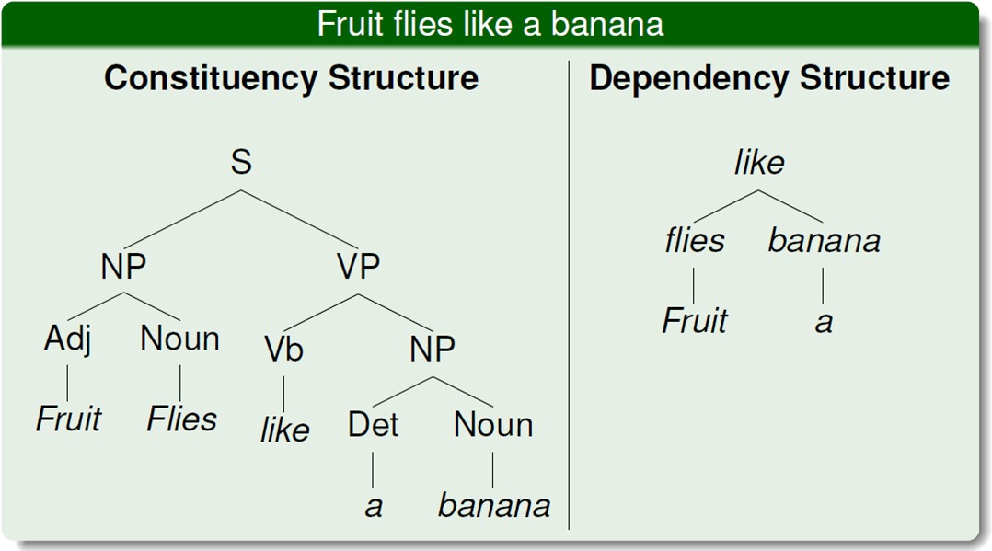
Syntactic Parsing
18

Slide 19
In natural language processing, entity linking, also referred to as named-entity linking (NEL),^{[1]} named-entity disambiguation (NED), named-entity recognition and disambiguation (NERD) or named-entity normalization (NEN)^{[2]} is the task of assigning a unique identity to entities (such as famous individuals, locations, or companies) mentioned in text. Coreference resolution is the task of finding all expressions that refer to the same entity in a text. It is an important step for a lot of higher level NLP tasks that involve natural language understanding such as document summarization, question answering, and information extraction.

Slide 20
Entity Linking
en.wikipedia.org/wiki/Dell Infobox type: company
en.wikipedia.org/wiki/Michael_Dell Infobox type: person
ORGANIZATION
PERSON
Revenues of $14.5 billion were posted by Dell1. The company1 ...
Coreference Resolution
figure credit: Durrett & Klein (2014)
20

Slide 21
“Winograd Schema”
Coreference Resolution
The man couldn't lift his son because he was so weak.
The man couldn't lift his son because he was so heavy.
21

Slide 22


“Winograd Schema”
Coreference Resolution
The man couldn't lift his son because he was so weak.
man
The man couldn't lift his son because he was so heavy.
son
22

Slide 23
Reading Comprehension
Once there was a boy named Fritz who loved to draw. He drew everything. In the morning, he drew a picture of his cereal with milk. His papa said, “Don’t draw your cereal. Eat it!”
After school, Fritz drew a picture of his bicycle. His uncle said, “Don't draw your bicycle. Ride it!”
…
What did Fritz draw first?
the toothpaste
his mama
cereal and milk
his bicycle
23

Slide 24
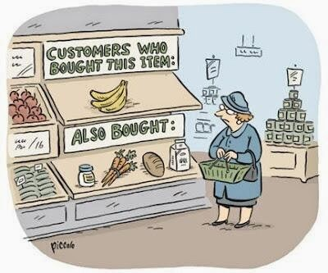
Conspicuous by their absence…
speech recognition (see TTIC 31110)
information retrieval and web search
knowledge representation
recommender systems

Slide 25
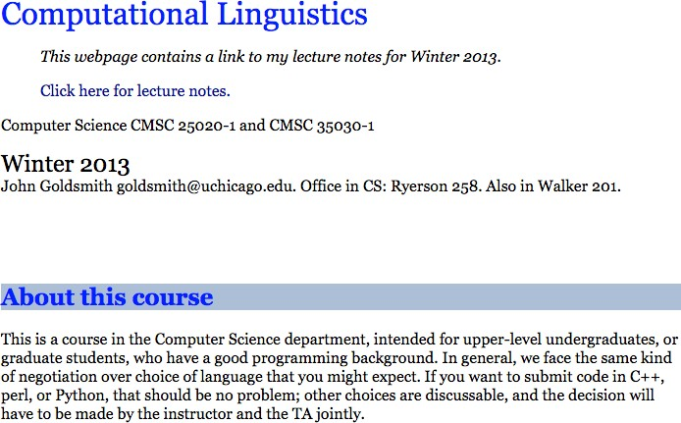
Computational Linguistics vs. Natural Language Processing
how do they differ?

Slide 26
Computational Linguistics vs. Natural Language Processing
many people think of the two terms as synonyms
computational linguistics is more inclusive; more likely to include sociolinguistics, cognitive linguistics, and computational social science
NLP is more likely to use machine learning and involve engineering / system-building

